Slide 1
Integracon Technologies Quality ● Uniqueness ● Simplicity

Slide 2
Integracon Technologies
Founded in 2001 and profitable every year in business
Service over 300 companies
First VMware Enterprise Certified company in Knoxville
Served 6 of the largest entities in Knoxville
Deep understanding of IT networks
We build value into everything we do!

Slide 3
Our Solution – Overview
Allows us to do better business with you and save you money
24 x 7 Monitoring
Alerting
Reporting

Slide 4
Our Enhanced Program
Asset Management
Security Assurance
Deep network monitoring
Immediate alerting
Automated network scanning and asset discovery
Asset inventory and warranty management
Baseline security scanning to detect security holes
Remote monitoring of antivirus and backup verification
Basic automated scripting to maintain asset health
Reporting
Preventative Maintenance
Comprehensive automated reporting (scheduled daily, weekly, monthly, quarterly, on-demand)
Quarterly Business Reviews
Detailed needs assessment
Setting objectives and planning for improvement
Comprehensive server health reports
Monitoring & Alerting

Slide 5
24x7 Monitoring, Alerting and Reporting
24 x 7 x 365 monitoring of your entire environment
Immediate alerting when issues arise
Long-term trend analysis and best practices solutions
Best Engineer for the IT challenge
Detailed monthly reporting

Slide 6
24x7 Monitoring, Alerting and Reporting
BENEFITS TO YOU:
24 x 7 Monitoring and Alerting
Issues will be identified much faster and addressed proactively.
With rapid resolution and problem prevention, we will substantially reduce the costs associated with downtime (lost productivity, lost opportunities and service costs)
Monthly Reporting
You’ll know exactly what’s going on in your network
You’ll know about pending problems and be able to plan accordingly

Slide 7
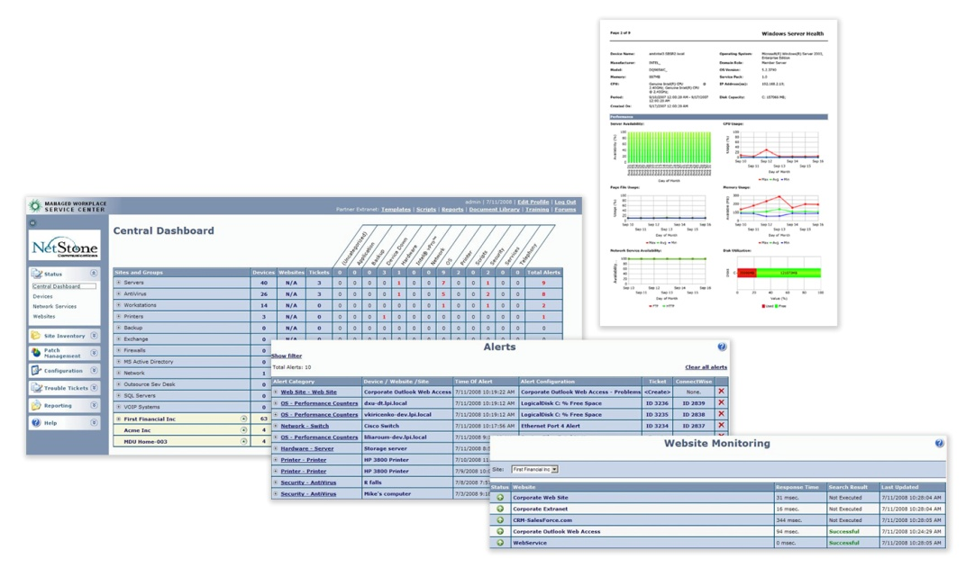
24x7 Monitoring
Network and device availability
Alerts and pre-failure indicators
Immediate alerting and monthly reporting
Centralized web-based dashboard
Server Health Report
Alerts
Website Monitoring

Slide 8
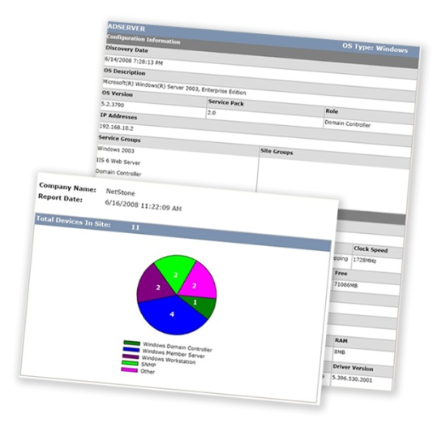
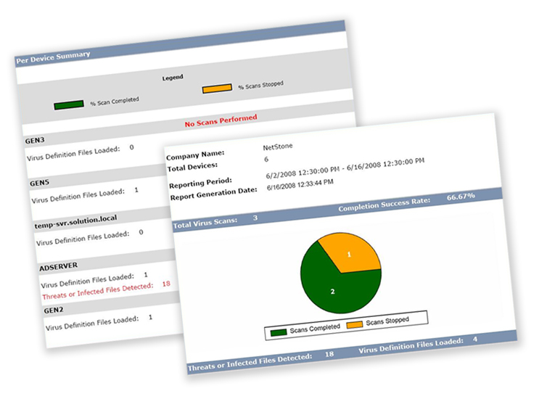
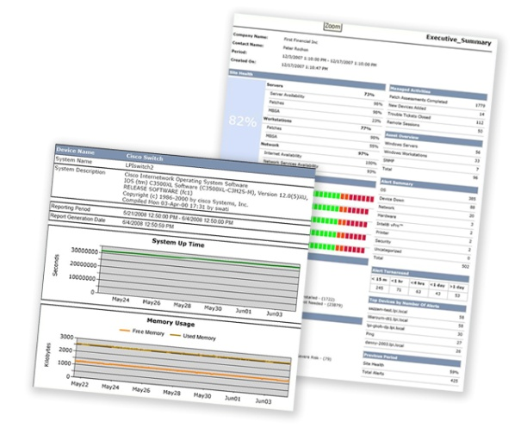
Initial Network Assessment
Site Hardware Summary Report
Complete overview of your network and its diversity of equipment
Easy identification of obsolete hardware that decreases employee productivity
Site Security Report
Comprehensive summary of all security patches applied
Complete summary of all MBSA scans performed
Summary of work required to improve site security
Site Performance Report
Identifies most heavily-stressed devices at a site
Highlights devices that may require immediate review

Slide 9
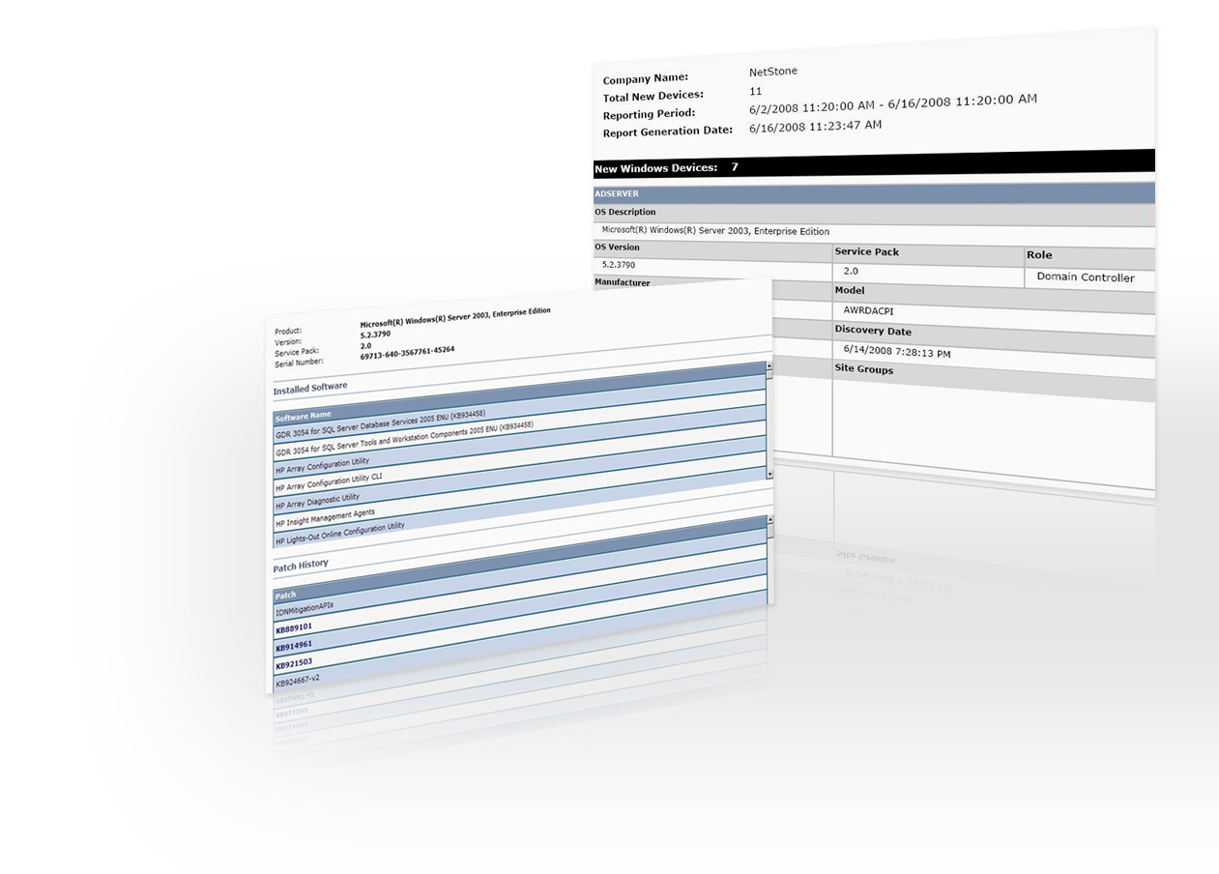
Detailed Network Scans
Scans are run on a predefined schedule
Automatic discovery of new assets
Scans can include anything with an IP address, including:
Desktops
Laptops
Servers
Network devices such as routers and switches
Network-attached devices such as printers, fax, scanners, VoIP phones
Websites (internal and external)
Virtual, cloud and SaaS resources

Slide 10
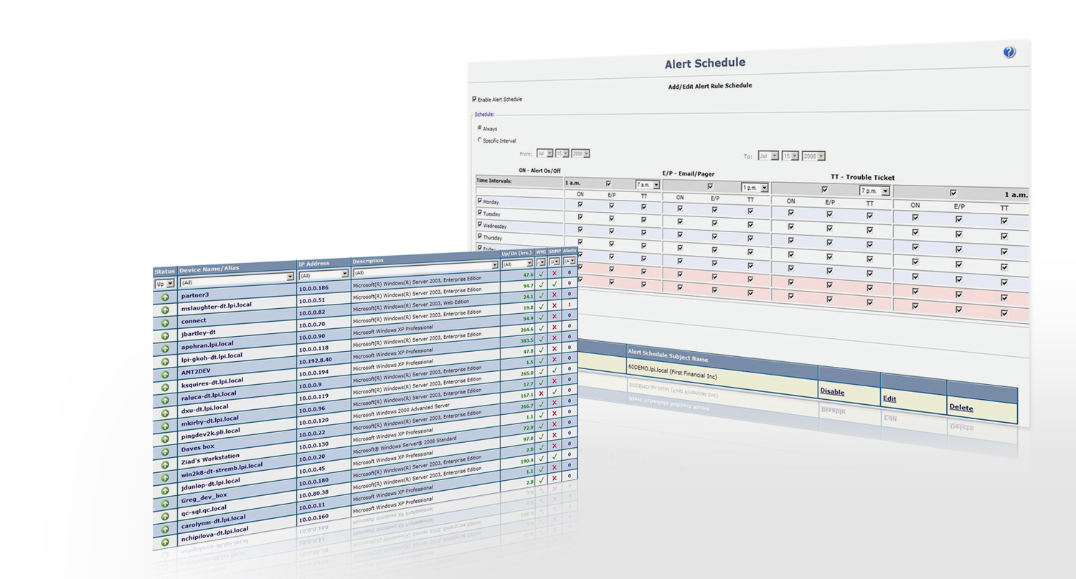
Monitoring All Your Assets
Standardized monitoring of your entire network
24 x 7 alerting based on what is important for you and your business

Slide 11
Asset Tracking and Reporting
Initial network assessment
Asset inventory management
Detailed network scans
Warranty and end-of-life tracking

Slide 12
Asset Tracking and Reporting
BENEFITS TO YOU:
Asset Inventory Management
Accurate, up-to-date, effortless asset and warranty tracking for insurance or taxation purposes
Protect your network from illegal or unauthorized software
Identify out-of-date or unsupported, inefficient hardware
Warranty and End-of-Life Asset Tracking
Reduce costs with more effective lifecycle tracking
Never pay for maintenance twice!

Slide 13
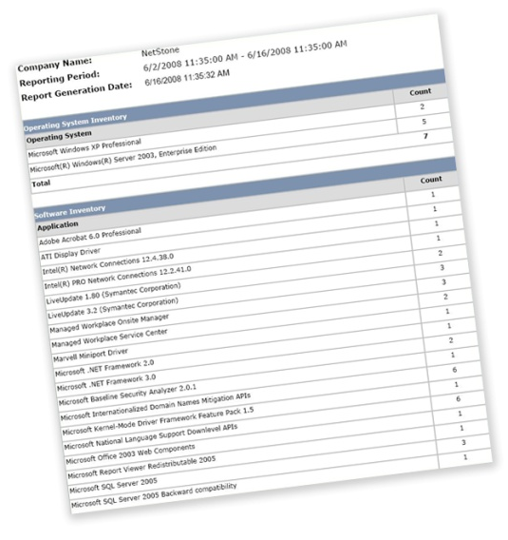
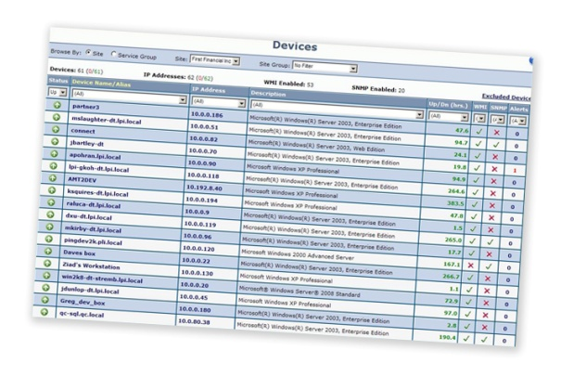
Asset Inventory Management
Hardware Assets
Detailed hardware inventory
Warranty tracking
Comprehensive monthly reporting
Software Assets
Complete list of all software patches applied to each system
Software detection to identify all unauthorized software installs
Detailed inventory of all systems
Sub-standard Configurations
Baseline Report identifies configurations that require updates
Asset scans identify under-performing and under-utilized devices

Slide 14
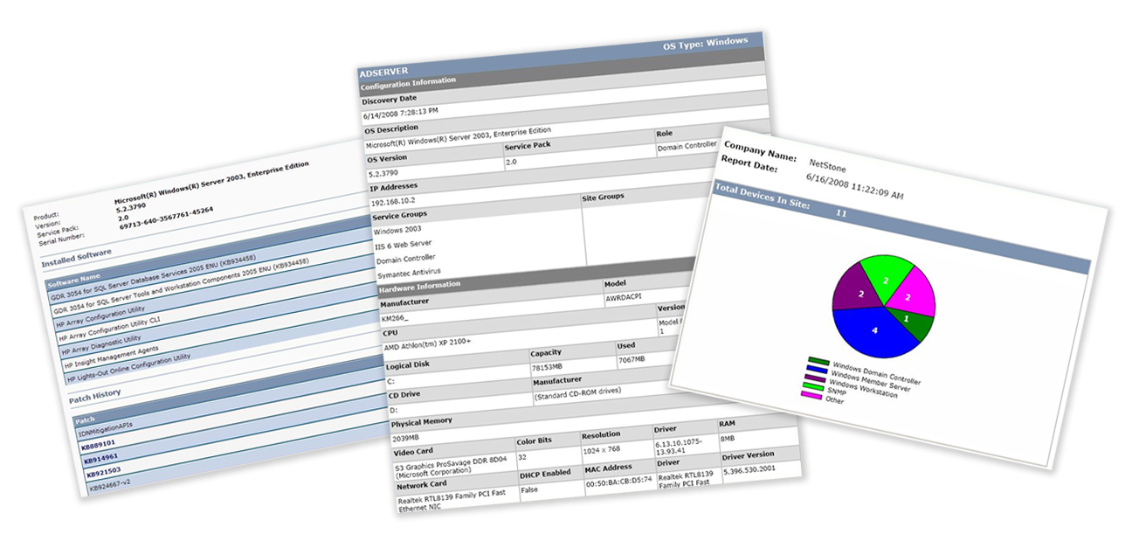
Warranty Tracking
Asset Inventory Reports – disaster recovery of mission-critical information
Device Attributes Report – up-to-date device warranty information
WE’LL MAKE SURE YOU DON’T PAY TWICE FOR HARDWARE MAINTENANCE!

Slide 15
Security Monitoring
Protecting your investment
Protecting your reputation
Ensuring compliance with legislated security regulations:
Sarbanes‐Oxley (Sarbox)
Gramm‐Leach‐Billey (GLBA) and/or Basel II
Payment Card Industry Data Security Standard (PCI‐DSS)
Health Information Portability & Accountability Act (HIPAA)
…everything that is relevant to your industry

Slide 16
Security Monitoring
BENEFITS TO YOU:
Protect Your Assets
Reduce the costs of downtime that can result from virus attack or security breaches.
Protect client data and your reputation.
Protecting Your Business
Achieve compliance to legislated regulations that apply to your business.
Increase customer confidence that their data is secure.

Slide 17
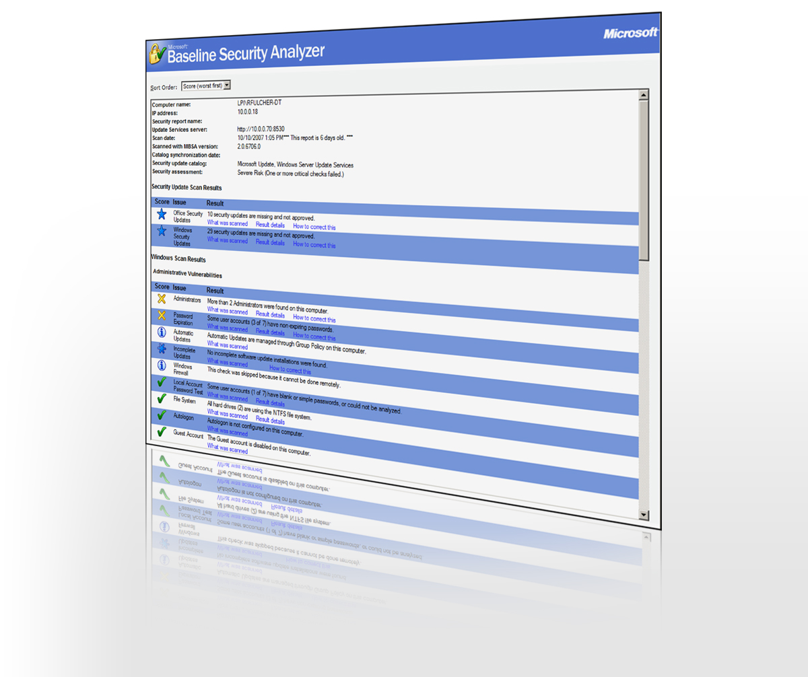
Security
REDUCED RISK
Baseline security scanning to detect security holes
Continuous monitoring for viruses, worms, spam ware and other malware
Automated verification of data back up completion
Identification of any failed back ups

Slide 18
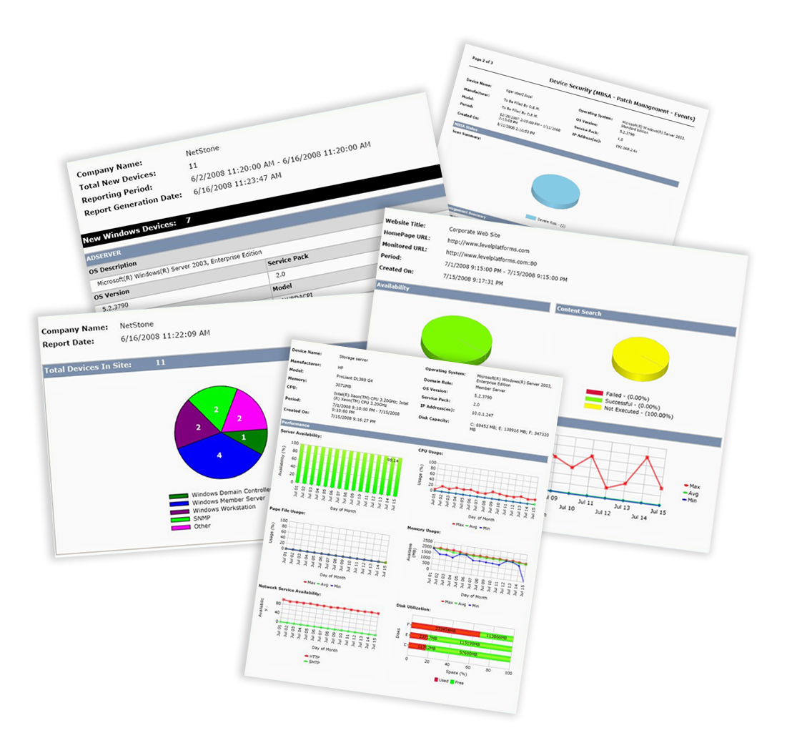
Compliance
Controlled environment
Physical security
Disaster management
Availability
Information security
Network security
Network health visibility
Reports: Patch Status, Hardware Summary, Device Security, Website Monitoring, Windows Server Health

Slide 19
Preventative Maintenance
Saving you money and improving productivity
Extend the longevity of your systems
Enhance employee productivity
Reduce wait times

Slide 20
Preventative Maintenance
BENEFITS TO YOU:
Most problems are solved before you even know they are happening
Lengthen asset life-cycle
Reduce the costs of downtime and emergency repairs
Increase productivity

Slide 21
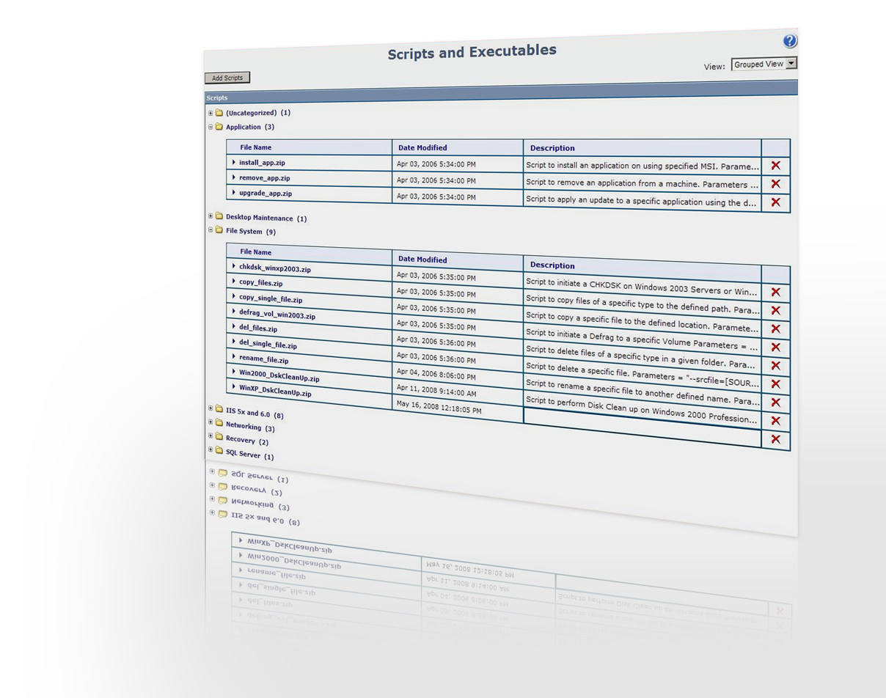
Preventative Maintenance
Settings are automated OR run on a predefined schedule
Shut down of workstations
Save power costs and reduce greenhouse gases
Clean-up of temporary files
Deletes all files in temporary directories
Remotely run scandisk
Provides security assurance

Slide 22
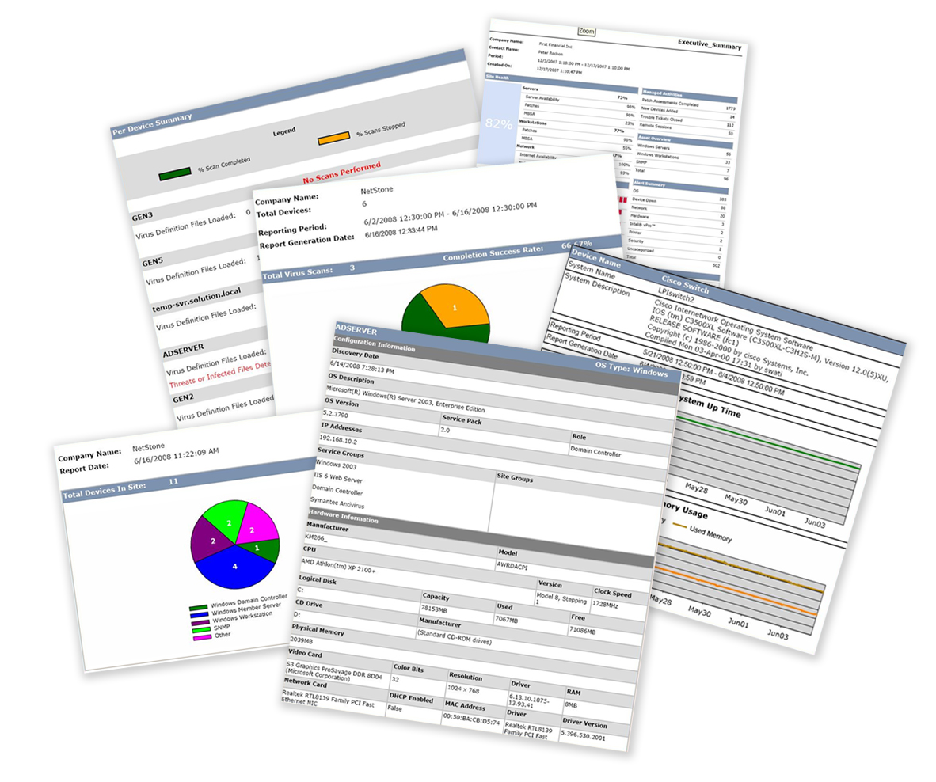
Monthly Reviews
Monthly reviews will help you to understand where, when and how to best invest your IT budget—and control costs.
Executive Summary
Provides an overview of entire site status
Website Monitoring
Up-to-date information on website reliability
Patch Status
Summarizes security patches that were applied for targeted devices
Server Health
Establishes performance baselines and identifies areas of improvement
Site Performance
Identifies the top most-stressed devices by memory usage and CPU
Work Completed
Summarizes information on cleared alerts, completed tickets, and scripts run

Slide 23
Quarterly Business Reviews
A pre-scheduled meeting every 90 days to review work and services, and to identify any areas of your IT infrastructure that are of concern.
Detailed review to refine our understanding of your needs and pain points
Review all reports and business processes tied to IT
Set objectives for the next quarter and start planning
Agree on ways to optimize your current IT investments and ways in which you can reduce costs

Slide 24
Overview – Benefits and Value
FEATURE
BENEFIT
VALUE
Monitoring & Alerting
Asset Management
Security Assurance
Issues will be identified much faster and can be addressed proactively
Accurate, up-to-date, effortless asset and warranty tracking for insurance or taxation purposes
Protect your assets and data
Lengthen asset life-cycle
Reporting
Preventative Maintenance
Know exactly what’s going on with your network
Quarterly Business Reviews
An opportunity to prioritize projects and plan budget
Increase productivity
Achieve regulatory compliance
Identify pending issues
Reduce costs of downtime (productivity, opportunity & service costs)
Reduce costs with better lifecycle management
Reduce costs of downtime
Increase customer confidence
Reduce costs of downtime and repairs
Optimize every dollar you spend on IT - based on accurate data
Accurate budget forecasting

Slide 25
You Win with Integracon Technologies
Reduce your IT costs
Reduce your unexpected downtime (and the costs associated with it)
Extend the life of your assets
Improve your system security
Plan, budget, and track more accurately
Be empowered to make proactive instead of reactive choices

Slide 26
Contact Information
Website: www.integracon.com
Telephone: (865)-330-2323
Email: sales@integracon.com

